Slide 1
PowerPoint Project 1
Mr. Campbell

Slide 2
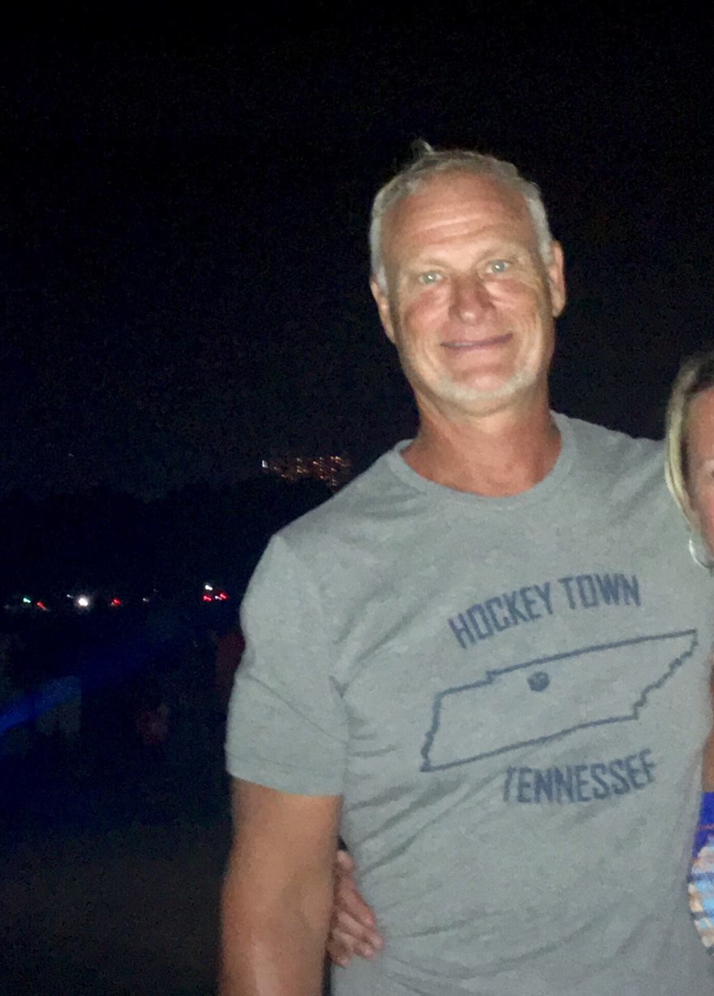
My School Picture

Slide 3
5 Things I do During the Day Since School Closure
Sleep
Eat
Pray
Work
Watch TV

Slide 4
Wash Your Hands
Social Distant
Stay Home

Slide 5
shapes
School Site

